Slide 1


Memory Game Based On Keypad & LCD
Made by :
Ahmed Mahmoud 231773
Mohamed Salah 238547
Abdullah Nasser 236985

Slide 2
Agenda
01- Abstract
02-Introduction
03-Project Objective
04- System Design & Components
05-Game Logic& Flow
06-Results & Observations
07-Conclusion

Slide 3
Abstract
A simple interactive memory game built using ATmega32, 4x4 keypad, and 16x2 LCD
Designed to help users enhance memory by repeating number sequences
Game starts easy and increases in difficulty with progression
Key features: Random number generation - Score tracking - Retry mechanism - Win/Loss states
Reads user input from keypad, displays sequences on LCD, and checks accuracy

Slide 4
Introduction
Memory games are useful tools to improve focus, memory, and pattern recognition
This project demonstrates how to build a standalone memory game using microcontroller-based hardware
Uses ATmega32 to interface with a 4x4 matrix keypad and a 16x2 LCD
Combines digital input/output, user interaction, and game logic
Offers hands-on experience in microcontroller programming and embedded

Slide 5
Project objective
Develop an interactive memory game that tests the user's ability to recall and repeat sequences
Connect and configure a 4x4 matrix keypad and 16x2 LCD with the ATmega32 microcontroller
Implement game logic and control flow using Embedded C
Integrate features like scoring, level progression, and a retry system
Display real-time feedback on the LCD based on the user's performance

Slide 6

System Design & Components
3.1 Hardware Components
• Microcontroller: ATmega32
• Display: 16x2 LCD
• Input Device: 4x4 Matrix Keypad
• Power Supply: 12V DC Battery connected to MOSFIT Regulator out 5V
3.2 Software Tools
• IDE: Atmel Studio (Microchip Studio)
• Simulator : Proteus 8
• Burner : eXtreme Burner - AVR
• AVR Programmer: USBasp

Slide 7
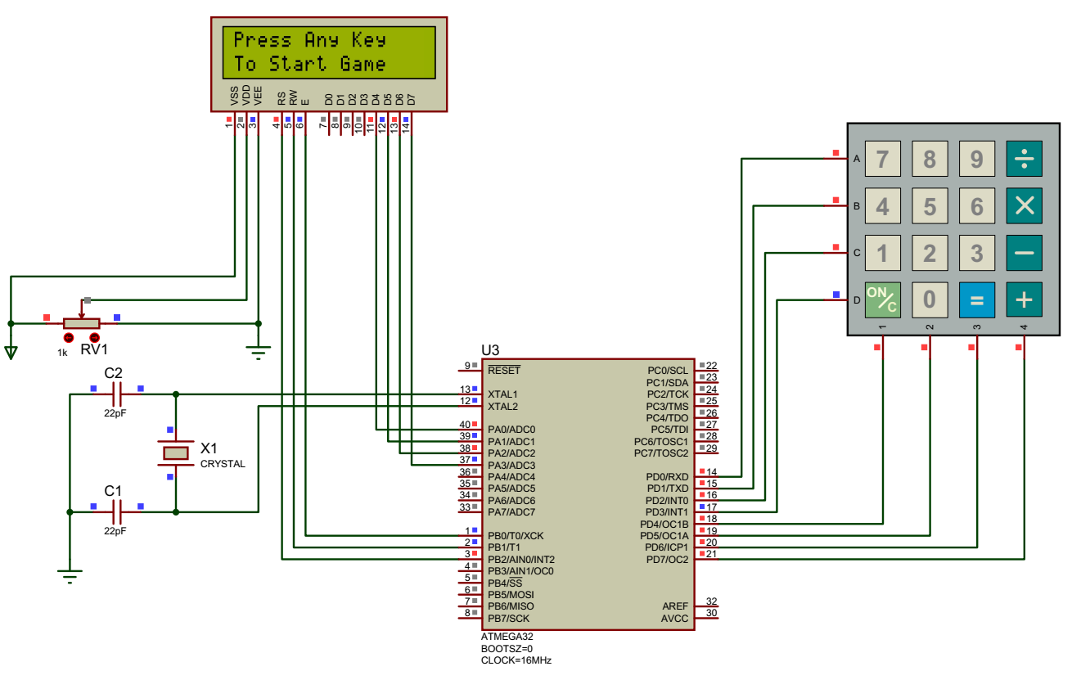
The Project Layout

Slide 8
Game Logic& Flow
Game begins when the user presses any key
A random number sequence is displayed on the LCD
User inputs the sequence using the keypad
The system compares the input with the original sequence
If correct:
Increase score and move to the next level
If incorrect:
Reduce remaining lives
Allow retry using the 'A' key
Game ends when:
All levels are completed → Win
No lives remaining → Game Over

Slide 9
Random Generation & Interfaces
Random Sequence Generation -Uses the Timer0 counter value for generating pseudo-random numbers -Values are manipulated to ensure variation in sequences -Numbers are converted to characters and displayed one by one on the LCD
LCD Interface -LCD operates in 4-bit mode to reduce I/O pin usage -Data and commands are sent in two 4-bit nibbles -Used to display sequences, scores, and feedback messages
Keypad Interface -4x4 keypad scanned using column-wise pull-down and row detection -One column is set LOW at a time while rows are read -Pressed key is identified based on active row-column combination

Slide 10
Results & Observations
The game performed reliably on the actual hardware setup
LCD displayed sequences and messages clearly and without delay
Keypad input was accurately detected and processed
The retry feature (using the 'A' key) improved user experience
Difficulty progression was smooth and intuitive for users
Scoring and level tracking functioned correctly throughout gameplay
Overall, the system provided an engaging and stable user experience

Slide 11
Conclusion
Successfully developed an interactive memory game using the ATmega32 microcontroller
Demonstrated effective integration of hardware components: keypad and LCD
Embedded C programming enabled smooth game logic and user interaction
Game features like scoring, retry, and difficulty progression worked as intended
Tested on real hardware with stable and accurate performance
Project highlights practical skills in microcontroller interfacing and embedded system design

Slide 12
Thanks for Listening

